Slide 1
Queues

Slide 2
Outline
This topic discusses the concept of a queue:
Description of an Abstract Queue
List applications
Implementation
Queuing theory
Standard Template Library

Slide 3
Abstract Queue
3.3
An Abstract Queue (Queue ADT) is an abstract data type that emphasizes specific operations:
Uses a explicit linear ordering
Insertions and removals are performed individually
There are no restrictions on objects inserted into (pushed onto) the queue—that object is designated the back of the queue
The object designated as the front of the queue is the object which was in the queue the longest
The remove operation (popping from the queue) removes the current front of the queue

Slide 4
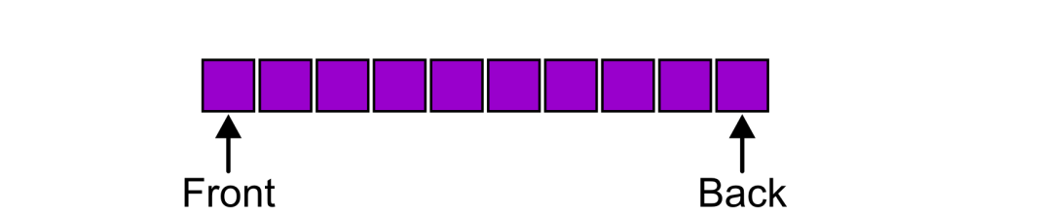
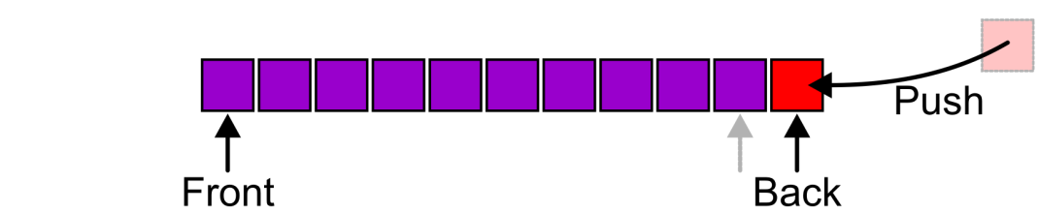
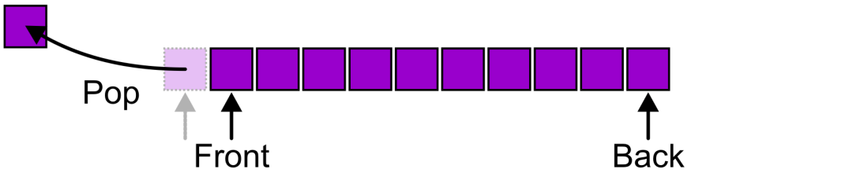
Abstract Queue
3.3.1
Also called a first-in–first-out (FIFO) data structure
Graphically, we may view these operations as follows:

Slide 5
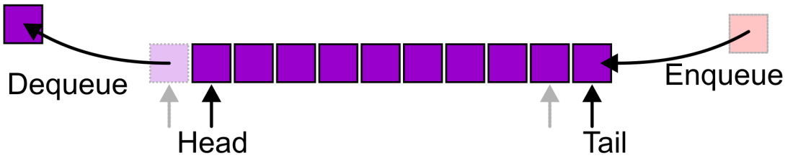
Abstract Queue
3.3.1
Alternative terms may be used for the four operations on a queue, including:

Slide 6
Abstract Queue
3.3.1
There are two exceptions associated with this abstract data structure:
It is an undefined operation to call either pop or front on an empty queue

Slide 7
Applications
3.3.2
The most common application is in client-server models
Multiple clients may be requesting services from one or more servers
Some clients may have to wait while the servers are busy
Those clients are placed in a queue and serviced in the order of arrival
Grocery stores, banks, and airport security use queues
The SSH Secure Shell and SFTP are clients
Most shared computer services are servers:
Web, file, ftp, database, mail, printers, WOW, etc.

Slide 8
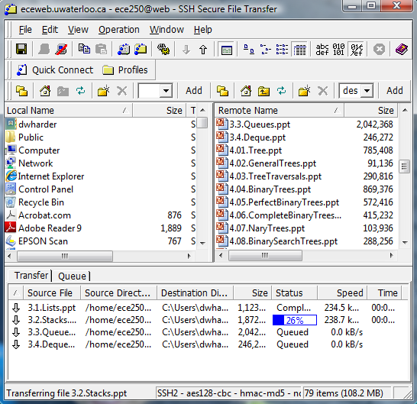
Applications
3.3.2
For example, in downloading these presentations from the ECE 250 web server, those requests not currently being downloaded are marked as “Queued”

Slide 9
Implementations
3.3.3
We will look at two implementations of queues:
Singly linked lists
Circular arrays
Requirements:
All queue operations must run in Θ(1) time

Slide 10
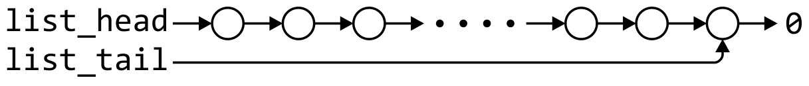
Linked-List Implementation
3.3.3.1
Removal is only possible at the front with Θ(1) run time
The desired behaviour of an Abstract Queue may be reproduced by performing insertions at the back
 | Front/1st | Back/n^{th}
Find | Θ(1) | Θ(1)
Insert | Θ(1) | Θ(1)
Erase | Θ(1) | Θ(n)

Slide 11
Single_list Definition
3.3.3.1
The definition of single list class from Project 1 is:
template <typename Type>
class Single_list {
public:
int size() const;
bool empty() const;
Type front() const;
Type back() const;
Single_node<Type> *head() const;
Single_node<Type> *tail() const;
int count( Type const & ) const;
void push_front( Type const & );
void push_back( Type const & );
Type pop_front();
int erase( Type const & );
};

Slide 12
Queue-as-List Class
3.3.3.1
The queue class using a singly linked list has a single private member variable: a singly linked list
template <typename Type>
class Queue{
private:
Single_list<Type> list;
public:
bool empty() const;
Type front() const;
void push( Type const & );
Type pop();
};

Slide 13
Queue-as-List Class
3.3.3.1
template <typename Type>
Type Queue<Type>::front() const {
if ( empty() ) {
throw underflow();
}
return list.front();
}
template <typename Type>
Type Queue<Type>::pop() {
if ( empty() ) {
throw underflow();
}
return list.pop_front();
}
The implementation is similar to that of a Stack-as-List
template <typename Type>
bool Queue<Type>::empty() const {
return list.empty();
}
template <typename Type>
void Queue<Type>::push( Type const &obj ) {
list.push_back( obj );
}
Notes:
13

Slide 14
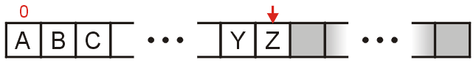
Array Implementation
3.3.3.2
A one-ended array does not allow all operations to occur in Θ(1) time
 | Front/1st | Back/n^{th}
Find | Θ(1) | Θ(1)
Insert | Θ(n) | Θ(1)
Erase | Θ(n) | Θ(1)

Slide 15
Array Implementation
3.3.3.2
Using a two-ended array, Θ(1) are possible by pushing at the back and popping from the front
 | Front/1st | Back/n^{th}
Find | Θ(1) | Θ(1)
Insert | Θ(1) | Θ(1)
Remove | Θ(1) | Θ(1)

Slide 16
Array Implementation
3.3.3.2
We need to store an array:
In C++, this is done by storing the address of the first entry
Type *array;
We need additional information, including:
The number of objects currently in the queue and the front and back indices
int queue_size;
int ifront; // index of the front entry
int iback; // index of the back entry
The capacity of the array
int array_capacity;
Notes:
16

Slide 17
Queue-as-Array Class
3.3.3.2
The class definition is similar to that of the Stack:
template <typename Type>
class Queue{
private:
int queue_size;
int ifront;
int iback;
int array_capacity;
Type *array;
public:
Queue( int = 10 );
~Queue();
bool empty() const;
Type front() const;
void push( Type const & );
Type pop();
};

Slide 18
Constructor
3.3.3.2
Before we initialize the values, we will state that
iback is the index of the most-recently pushed object
ifront is the index of the object at the front of the queue
To push, we will increment iback and place the new item at that location
To make sense of this, we will initialize
iback = -1;
ifront = 0;
After the first push, we will increment iback to 0, place the pushed item at that location, and now
Notes:
18

Slide 19
Constructor
3.3.3.2
Again, we must initialize the values
We must allocate memory for the array and initialize the member variables
The call to new Type[array_capacity] makes a request to the operating system for array_capacity objects
#include <algorithm>
// ...
template <typename Type>
Queue<Type>::Queue( int n ):
queue_size( 0 ),
iback( -1 ),
ifront( 0 ),
array_capacity( std::max(1, n) ),
array( new Type[array_capacity] ) {
// Empty constructor
}

Slide 20
Constructor
3.3.3.2
template <typename Type>
class Queue {
private:
int queue_size;
int iback;
int ifront;
int array_capacity;
Type *array;
public:
Queue( int = 10 );
~Queue();
bool empty() const;
Type top() const;
void push( Type const & );
Type pop();
};
template <typename Type>
Queue<Type>::Queue( int n ):
queue_size( 0 ),
iback( -1 ),
ifront( 0 ),
array_capacity( std::max(1, n) ),
array( new Type[array_capacity] )
{
// Empty constructor
}
Reminder:
Initialization is performed in the order specified in the class declaration
Notes:
20

Slide 21
Destructor
3.3.3.2
The destructor is unchanged from Stack-as-Array:
template <typename Type>
Queue<Type>::~Queue() {
delete [] array;
}

Slide 22
Member Functions
3.3.3.2
These two functions are similar in behaviour:
template <typename Type>
bool Queue<Type>::empty() const {
return ( queue_size == 0 );
}
template <typename Type>
Type Queue<Type>::front() const {
if ( empty() ) {
throw underflow();
}
return array[ifront];
}

Slide 23
Member Functions
3.3.3.2
template <typename Type>
Type Queue<Type>::pop() {
if ( empty() ) {
throw underflow();
}
--queue_size;
++ifront;
return array[ifront - 1];
}
However, a naïve implementation of push and pop will cause difficulties:
template <typename Type>
void Queue<Type>::push( Type const &obj ) {
if ( queue_size == array_capacity ) {
throw overflow();
}
++iback;
array[iback] = obj;
++queue_size;
}
Notes:
23

Slide 24
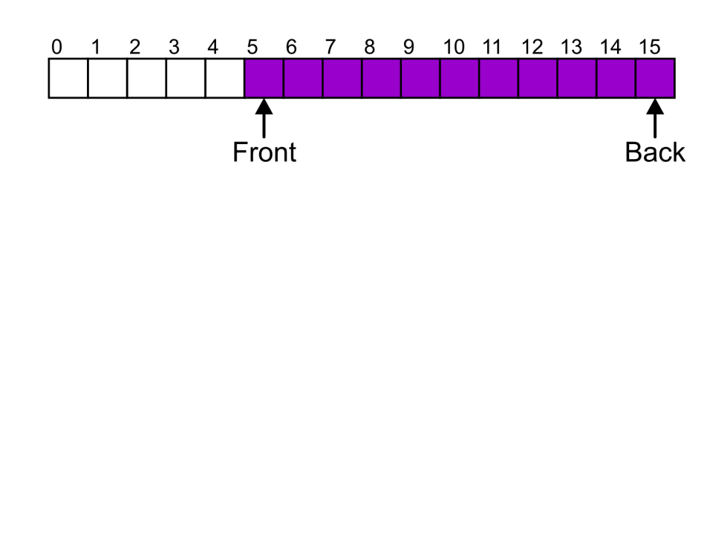
Member Functions
3.3.3.2
Suppose that:
The array capacity is 16
We have performed 16 pushes
We have performed 5 pops
The queue size is now 11
We perform one further push
In this case, the array is not full and yet we cannot place any more objects in to the array
Notes:
24

Slide 25
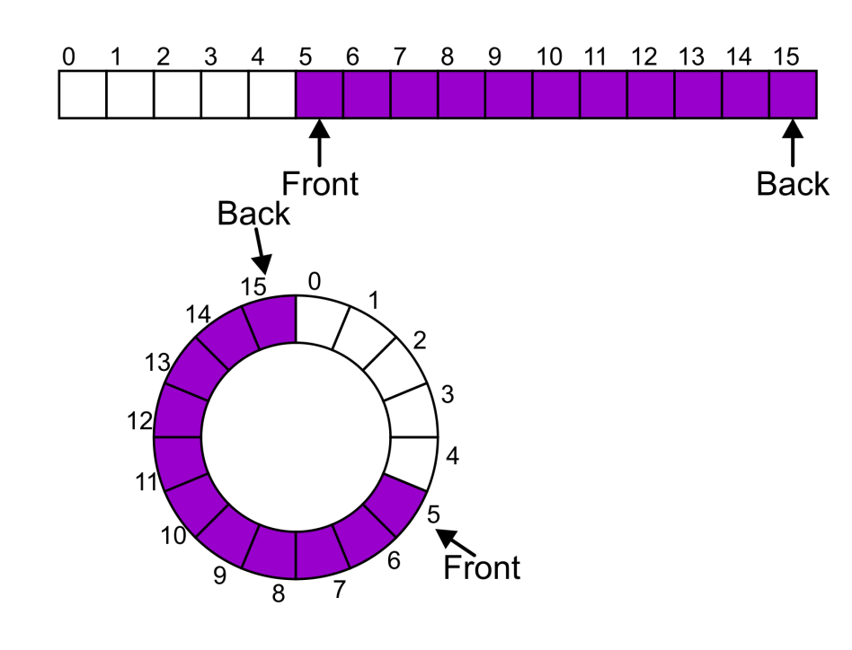
Member Functions
3.3.3.2
Instead of viewing the array on the range 0, …, 15, consider the indices being cyclic:
…, 15, 0, 1, …, 15, 0, 1, …, 15, 0, 1, …
This is referred to as a circular array
Notes:
25

Slide 26
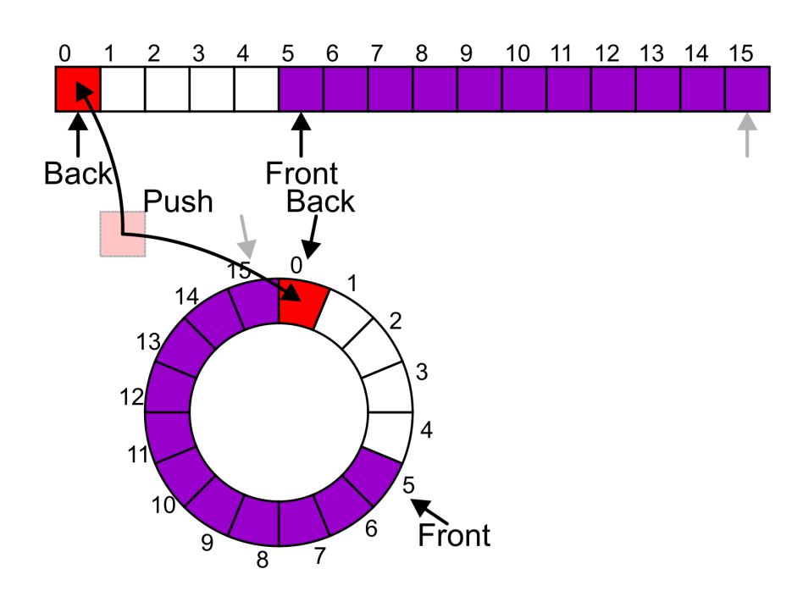
Member Functions
3.3.3.2
Now, the next push may be performed in the next available location of the circular array:
++iback;
if ( iback == capacity() ) {
iback = 0;
}
Notes:
26

Slide 27
Exceptions
3.3.3.2
As with a stack, there are a number of options which can be used if the array is filled
If the array is filled, we have five options:
Increase the size of the array
Throw an exception
Ignore the element being pushed
Put the pushing process to “sleep” until something else pops the front of the queue
Include a member function bool full()

Slide 28
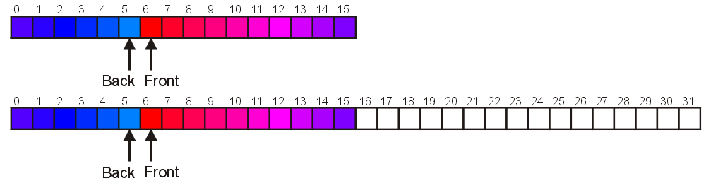
Increasing Capacity
3.3.4
Unfortunately, if we choose to increase the capacity, this becomes slightly more complex
A direct copy does not work:

Slide 29
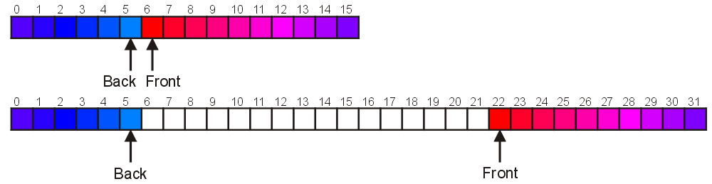
Increasing Capacity
3.3.4
There are two solutions:
Move those beyond the front to the end of the array
The next push would then occur in position 6
Notes:
29

Slide 30
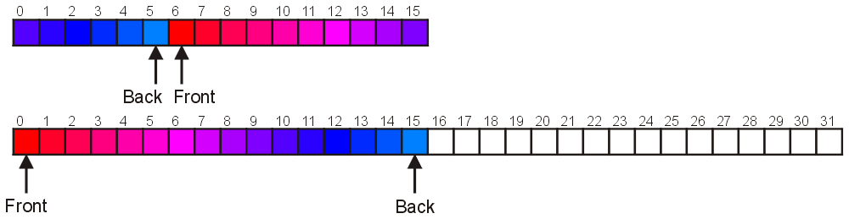
Increasing Capacity
3.3.4
An alternate solution is normalization:
Map the front back at position 0
The next push would then occur in position 16
Notes:
30

Slide 31
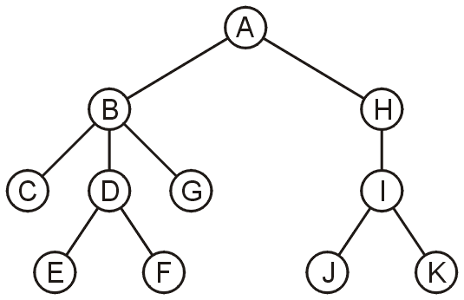
Application
3.3.5
Another application is performing a breadth-first traversal of a directory tree
Consider searching the directory structure

Slide 32
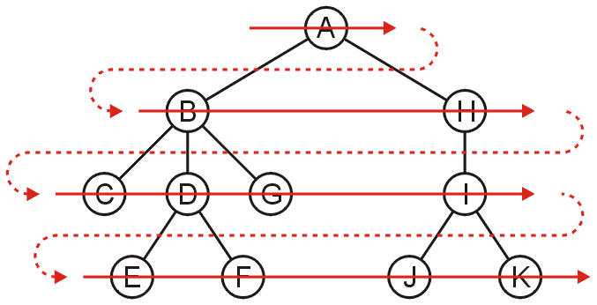
Application
3.3.5
We would rather search the more shallow directories first then plunge deep into searching one sub-directory and all of its contents
One such search is called a breadth-first traversal
Search all the directories at one level before descending a level

Slide 33
Application
3.3.5
The easiest implementation is:
Place the root directory into a queue
While the queue is not empty:
Pop the directory at the front of the queue
Push all of its sub-directories into the queue
The order in which the directories come out of the queue will be in breadth-first order

Slide 34
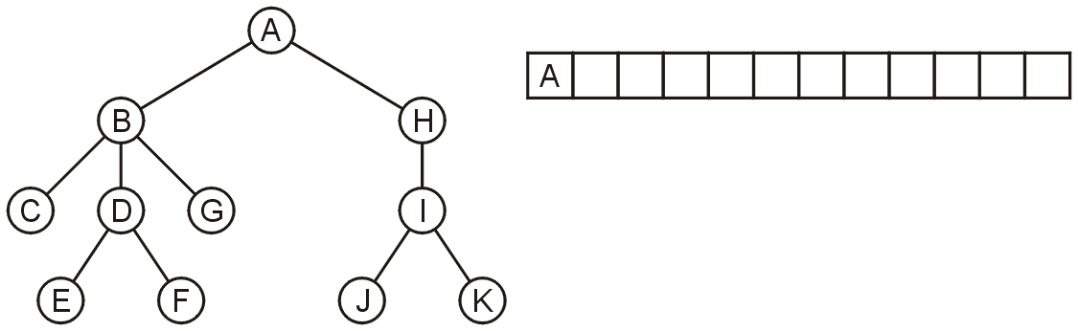
Application
3.3.5
Push the root directory A

Slide 35
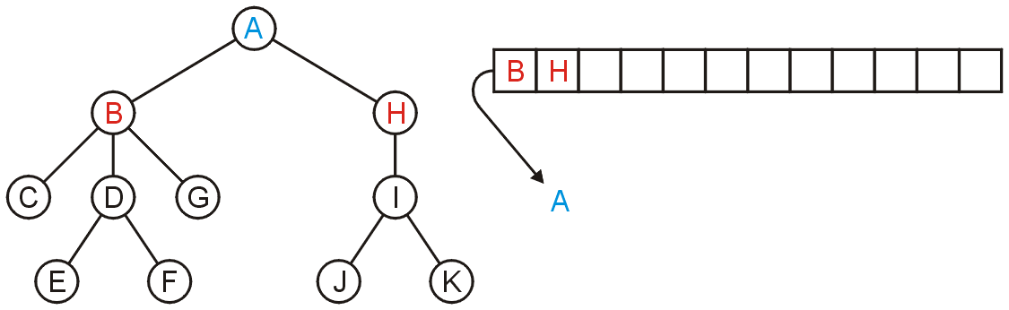
Application
3.3.5
Pop A and push its two sub-directories: B and H

Slide 36
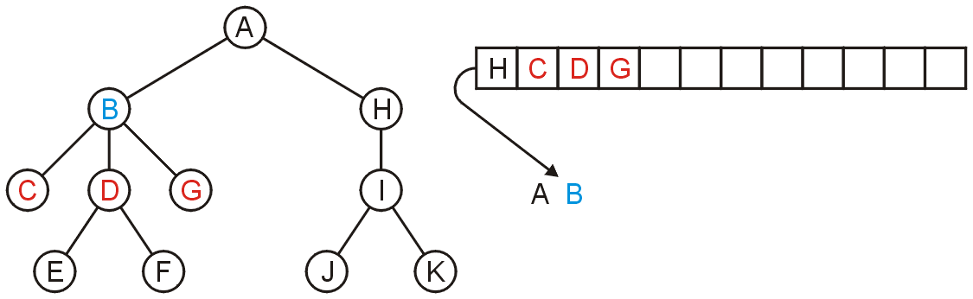
Application
3.3.5
Pop B and push C, D, and G

Slide 37
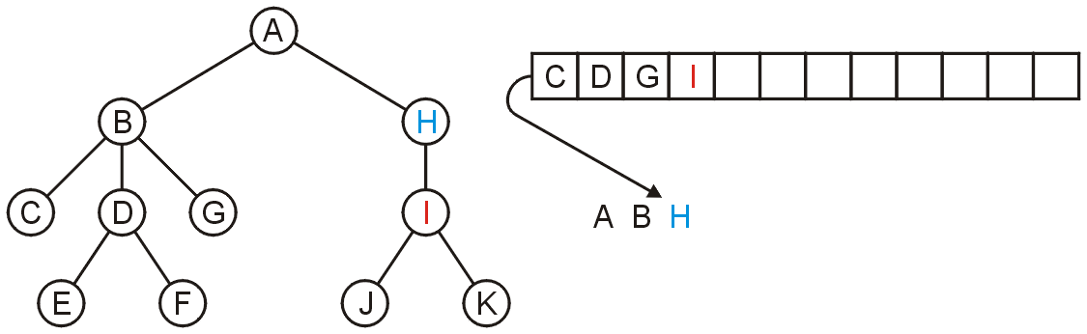
Application
3.3.5
Pop H and push its one sub-directory I

Slide 38
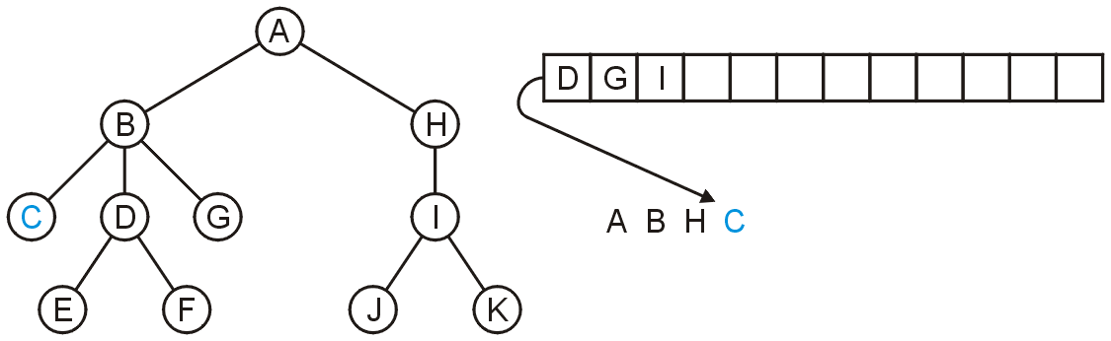
Application
3.3.5
Pop C: no sub-directories

Slide 39
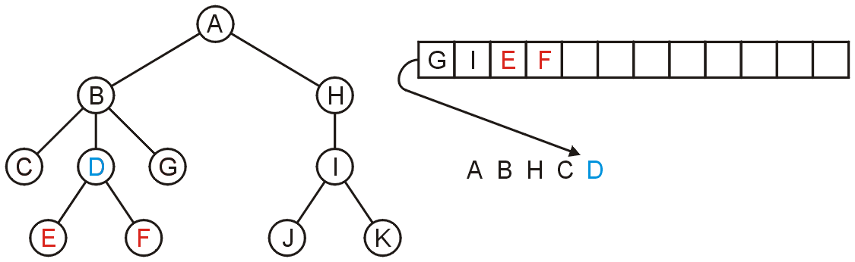
Application
3.3.5
Pop D and push E and F

Slide 40
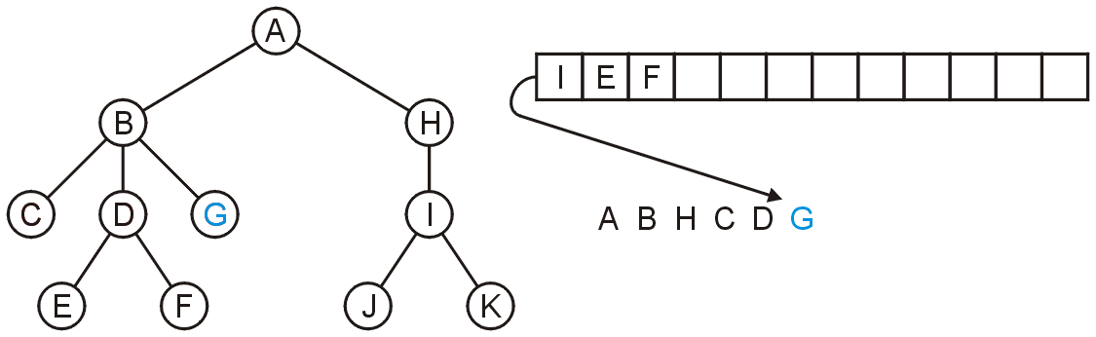
Application
3.3.5
Pop G

Slide 41
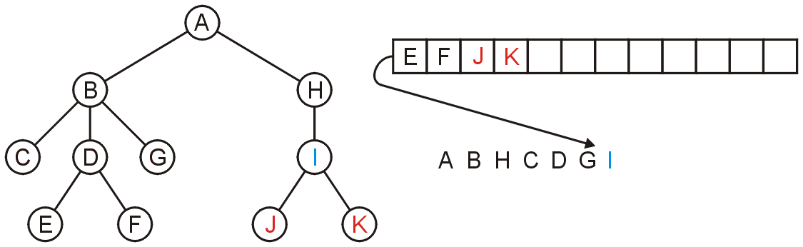
Application
3.3.5
Pop I and push J and K

Slide 42
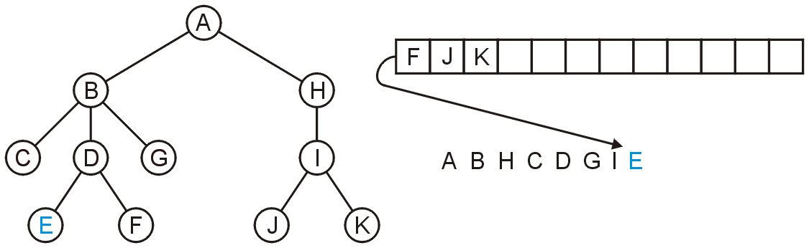
Application
3.3.5
Pop E

Slide 43
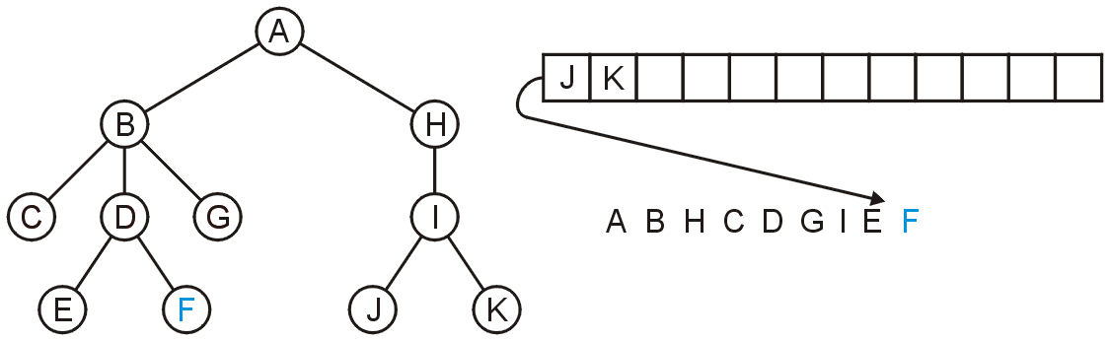
Application
3.3.5
Pop F

Slide 44
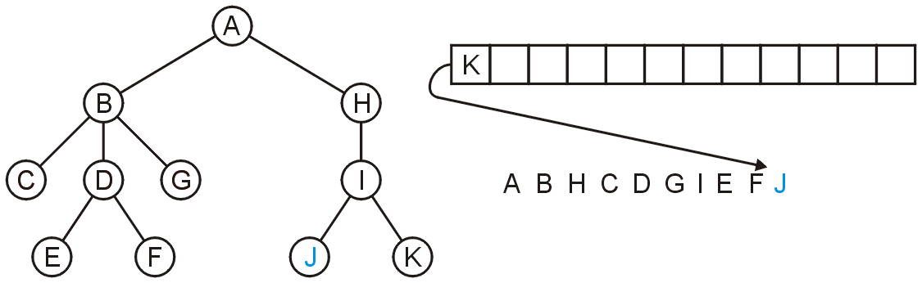
Application
3.3.5
Pop J

Slide 45
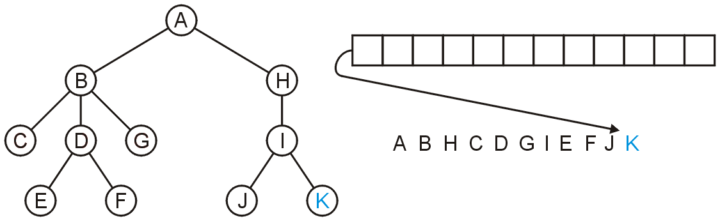
Application
3.3.5
Pop K and the queue is empty

Slide 46
Application
3.3.5
The resulting order
A B H C D G I E F J K
is in breadth-first order:

Slide 47
Standard Template Library
3.3.6
An example of a queue in the STL is:
#include <iostream>
#include <queue>
using namespace std;
int main() {
queue <int> iqueue;
iqueue.push( 13 );
iqueue.push( 42 );
cout << "Head: " << iqueue.front() << endl;
iqueue.pop(); // no return value
cout << "Head: " << iqueue.front() << endl;
cout << "Size: " << iqueue.size() << endl;
return 0;
}

Slide 48
Summary
The queue is one of the most common abstract data structures
Understanding how a queue works is trivial
The implementation is only slightly more difficult than that of a stack
Applications include:
Queuing clients in a client-server model
Breadth-first traversals of trees

Slide 49
References
Donald E. Knuth, The Art of Computer Programming, Volume 1: Fundamental Algorithms, 3rd Ed., Addison Wesley, 1997, §2.2.1, p.238.
Cormen, Leiserson, and Rivest, Introduction to Algorithms, McGraw Hill, 1990, §11.1, p.200.
Weiss, Data Structures and Algorithm Analysis in C++, 3rd Ed., Addison Wesley, §3.6, p.94.
Koffman and Wolfgang, “Objects, Abstraction, Data Strucutes and Design using C++”, John Wiley & Sons, Inc., Ch. 6.
Wikipedia, http://en.wikipedia.org/wiki/Queue_(abstract_data_type)
These slides are provided for the ECE 250 Algorithms and Data Structures course. The material in it reflects Douglas W. Harder’s best judgment in light of the information available to him at the time of preparation. Any reliance on these course slides by any party for any other purpose are the responsibility of such parties. Douglas W. Harder accepts no responsibility for damages, if any, suffered by any party as a result of decisions made or actions based on these course slides for any other purpose than that for which it was intended.

